Slide 1
Microservices and DevOps
Scalable Microservices
Monitoring
Henrik Bærbak Christensen
Notes:
Newman §8!

Slide 2
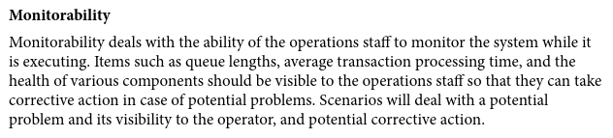
Monitorability
According to Bass et al. (2012)
Ability to monitor system while executing, to take corrective action in case of potential problems

Slide 3
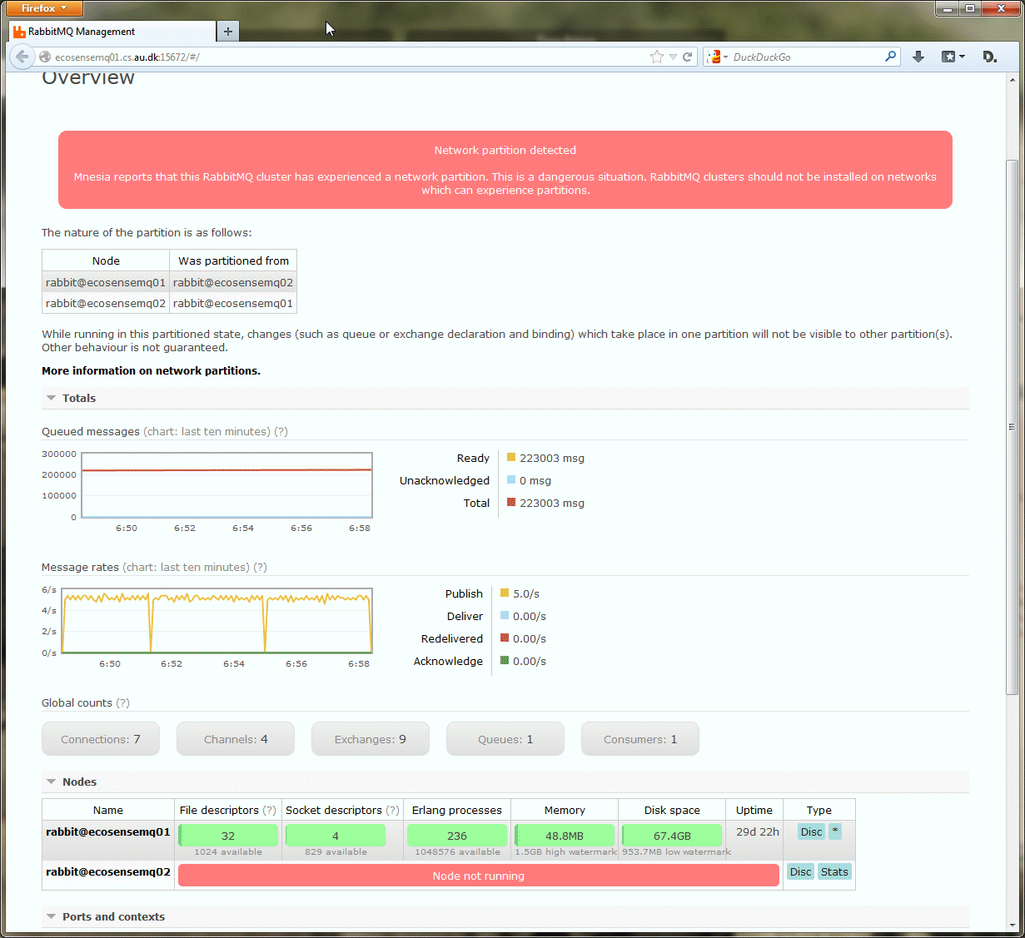
From my own backyard…
Christmas lunch with the family
Ups…
What’s the first thing you want to know? What the hell has gone wrong?
Easier in a monolith
One system, one log
Microservices?
30 systems, one big mess

Slide 4
Monitor System
So – what do we want to monitor?
Data that allows us corrective action
Which boils down to three things
That we have data – live and historic
That is, our services must provide data
That data provides the information that allows corrective action
That is, our services must provide the right and relevant data
And – that we can actually find/overview that required data
That is, our services’ data is available, searchable, and meaningful

Slide 5
Monitor System
So – what do we want to monitor?
Data that allows us corrective action
And what data may that be?
Three major classes
Hardware related data: CPU, Disk, IO, Memory, …
Domain related data: User behavior, Access patterns,
Architecture related data: Performance, Availability, …
Requires set of tools and techniques

Slide 6
Metric Types
Three major classes
Hardware related data: CPU, Disk, IO, Memory, …
Domain related data: User behavior, Access patterns,
Architecture related data: Performance, Availability, …
Alternative, not completely orthogonal terms
System metrics Operating system/hardware
Platform metrics Framework/JVM
Application metrics Own logging at application level
Splunk terminology
Logging for debug, Semantic Logging

Slide 7
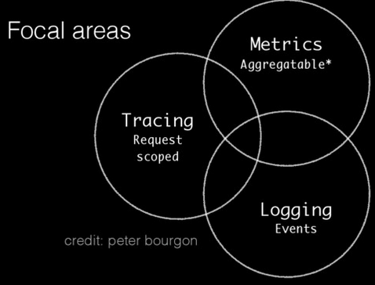
Terminology
Newman is in his usual ‘hand waiving’ mode
Adrian Cole defines Observability
Logs recording events
Metrics data combined from measuring events
Tracing recording events with causal ordering
Ex
Log quote service failure
Measure # users each hour
Trace call seq for cmd ‘quote’ command
https://www.dotconferences.com/2017/04/adrian-cole-observability-3-ways-logging-metrics-tracing
Notes:
https://www.dotconferences.com/2017/04/adrian-cole-observability-3-ways-logging-metrics-tracing

Slide 8
Monitoring Anti-thesis
Let us try to negate the statement
Data that allows us corrective action
What can lead to situations in which we cannot start corrective actions?
Exercise – your system breaks and you cannot correct
Name the issues that may lead to this situation…
Notes:
If there is no data related to the issue we face (no monitoring at all, no log messages related to the issue at hand, no logging of domain related stuff)
If data is not aggregated into a single, searchable place, leading to too cumbersome to diagnose the fault cause
If data is ill structured: You know it is there but you simply cannot find it
If individual data items are not correctly correlated: No tracability about which events are grouped to a particular customer, execution trace, etc.

Slide 9
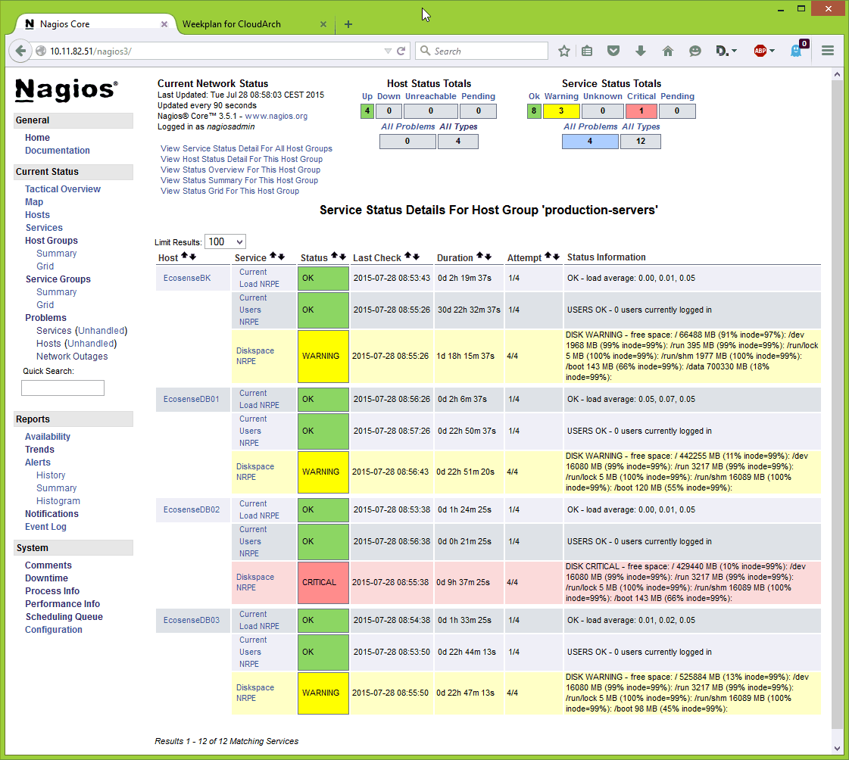
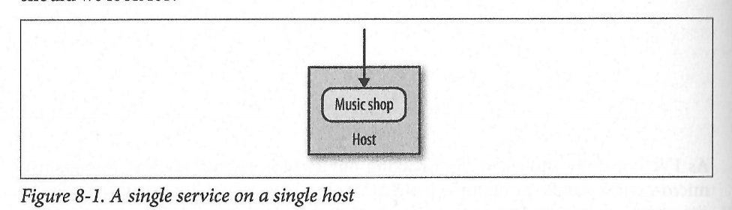
Single Service, Single Server
The ‘simple case’
Monitor the machine
Nagios, ‘htop’, …
Access to log files
Ssh, and ‘more’ ☺
Application monitoring
E.g. response time

Slide 10
Metrics Collection
Actually a bit of application metrics is collected by the URITunnelServerRequestHandler of the Frds.Broker library:

Slide 11
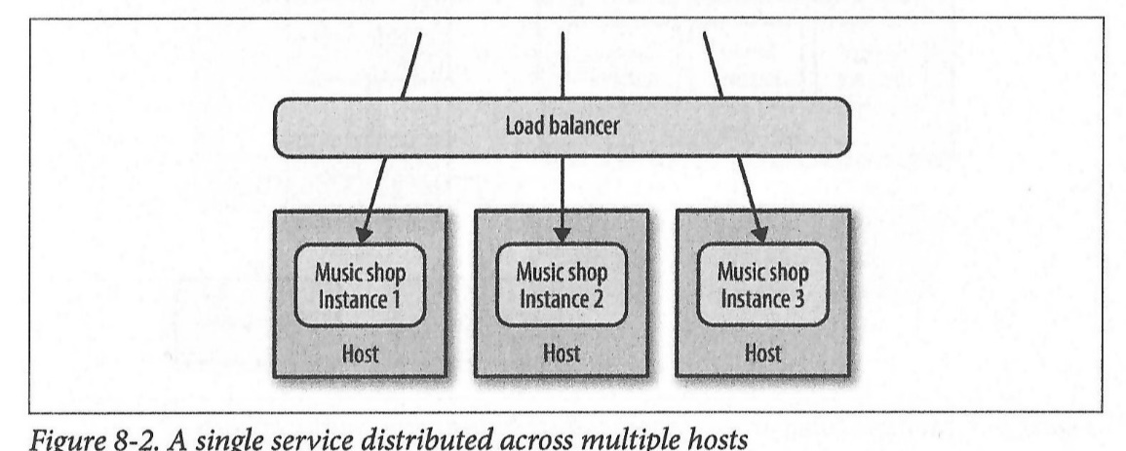
Single Service, Multiple Servers
Horizontal Scaling
Monitor all machines
Aggregate logs!

Slide 12
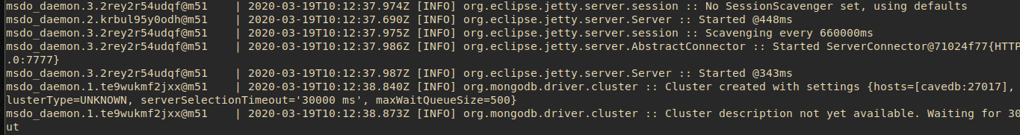
Swarm Aggregates Logs
On a per-service level
Which makes sense…
However, to diagnose one service some filtering is required

Slide 13
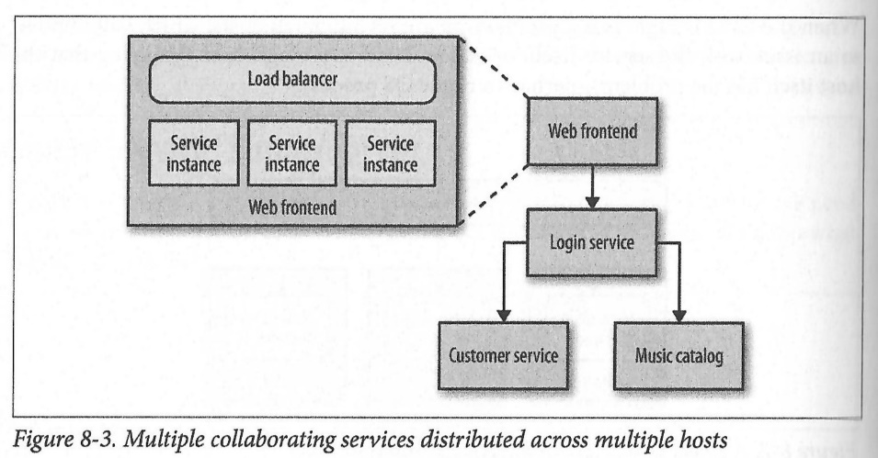
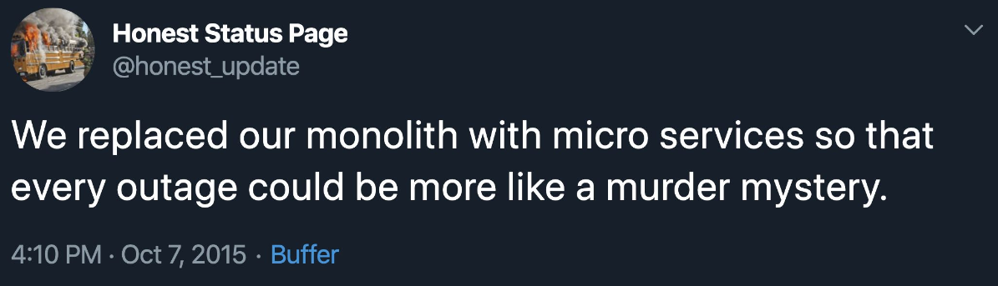
Multiple Services, Multiple Servers
Now it gets nasty ☹
”Answer is collection and central aggregation” [Newman, p 158]

Slide 14
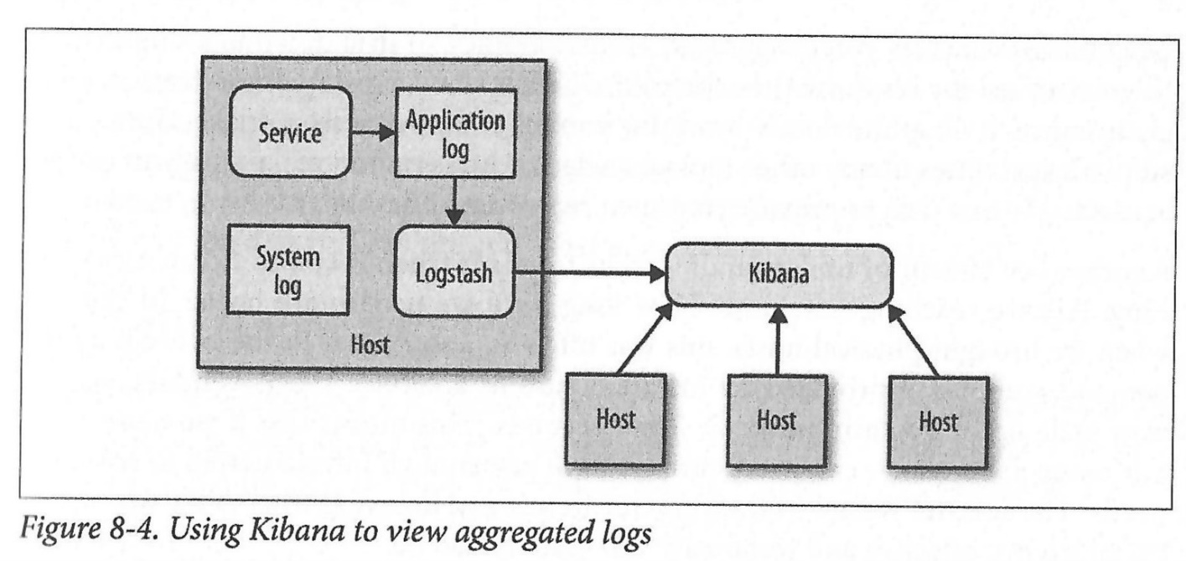
Aggregation
So – we need something to aggregate logs from many individual services…
ElasticSearch

Slide 15
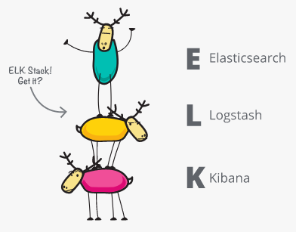
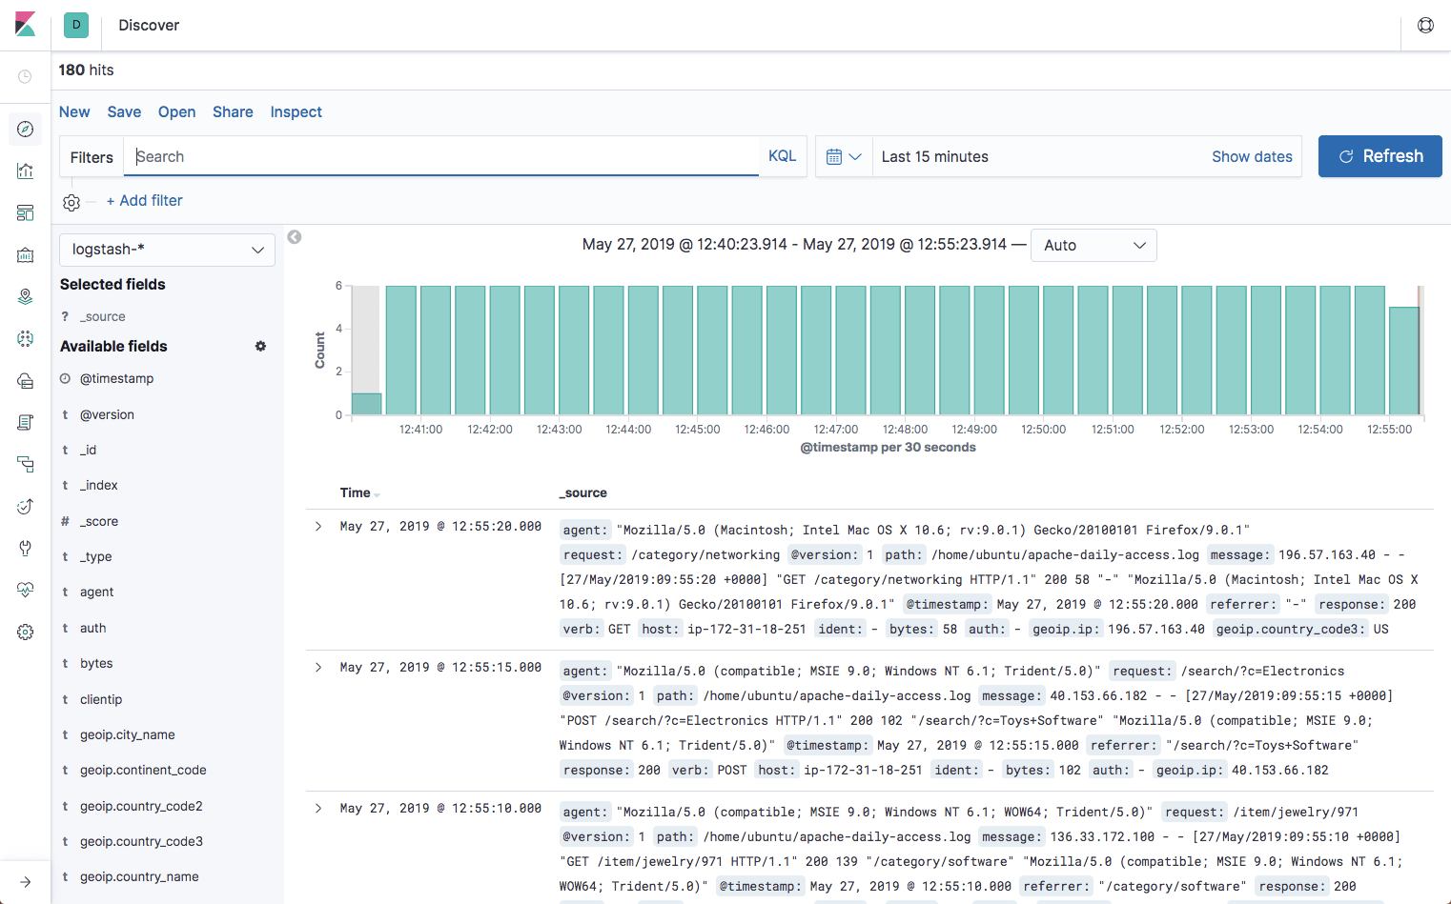
ELK
The classic solution to log aggregation is ELK
Logstash
Log ‘ingest pipeline’, collect logs from all services
Elasticsearch
JSON-based search engine
Kibana
Flexible visualization tool
Tried it for MSDO
☹ Really heavy machinery ☹
And hell to get going ☹

Slide 16
Service Metrics
Section is about what I would call ‘domain metrics’
Or ‘semantic logging’ in the Splunk paper
Our service logs data related to the domain it handles
Expose number of times customers view past orders
How big is today’s sales
Which features are use, and how often, and how
Why
Improve service based upon real data
Humble: ‘Are we building the right thing’ / scientific experiments
Notes:
Newman p 160ff

Slide 17
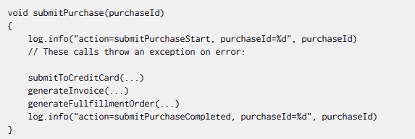
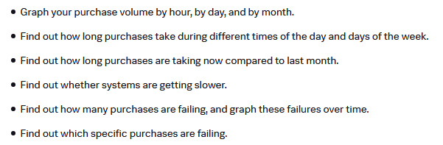
Example
Example (From the Splunk paper)
Notes:
From Splunk paper

Slide 18
Semantic Monitoring
Wrongly headlined as ‘Synthetic Monitoring’ in the book
Semantic Monitoring:
Insert synthetic transactions into the production environment
A synthetic transaction is a ‘fake event’
Can then be monitored for ‘proper behavior’ of system
Does system handle event properly within timelimit?
Of course, important to isolate from real events
WarStory:
Large number of washing machines arrived at head office ☺
Preferably over monitoring hardware metrics, like CPU
Blocked threads may halt a system even though CPU is fine…

Slide 19
Semantic Monitoring
How to do it?
Well, you already have the infrastructure ☺
It is a test journey! The test cases have (almost) been written.
Again, care must be taken to handle synthetic events in a way that does not influence real behaviors…

Slide 20
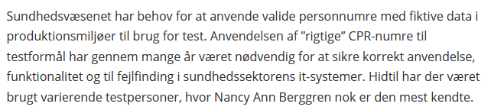
Similar Example
I worked in the HealthCare domain for some years
Nancy
251248-9996
She has suffered all diseases ever invented ☹
Source: MedCom website
Warstory: The letter to most wealthy customers of US bank.

Slide 21
Correlation ID
One big issue in MS architectures
Any given event/transaction may involve partial processing by a set of services
That is, there is not five log messages from the ‘processItem()’ method execution…
There are two log messages in one service, three in another, two in a third one, etc.
And all are interleaved with processing of other transactions!
Traceability is lost! No ‘stack-trace’ to diagnose ☹

Slide 22
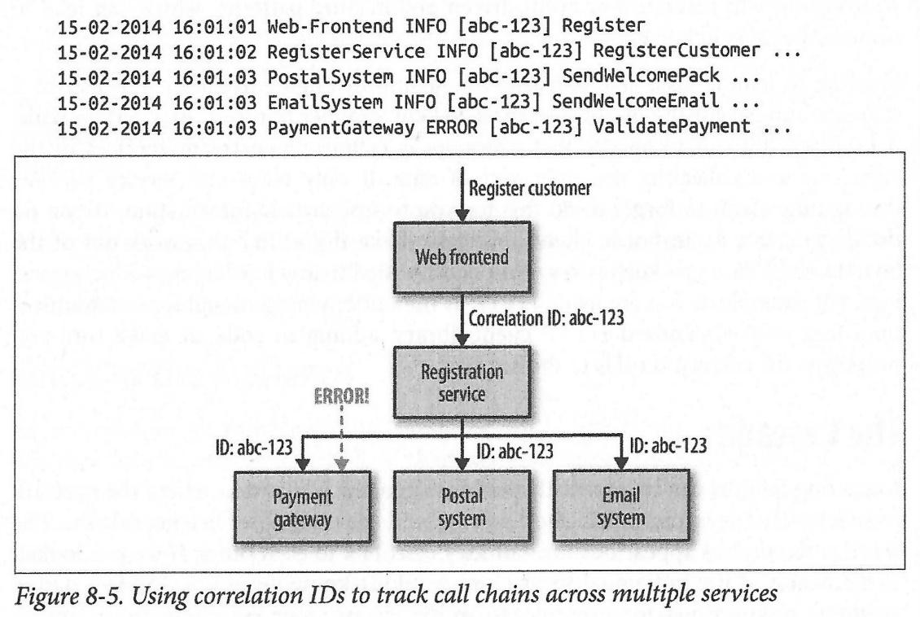
Correlation ID
Correlation ID:
A UUID generated by the initiating call, and then passed along to all subsequent calls

Slide 23
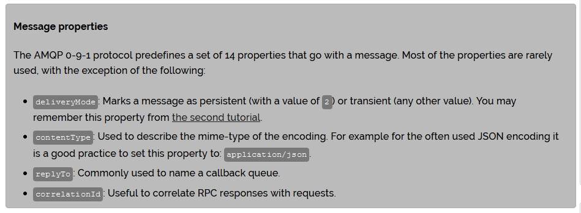
Example
RabbitMQ uses CorrelationId’s to match replies with proper requests when it simulates RCP calls

Slide 24
Exercise
SkyCave’s initiating call hits … where?
Is SkyCave prepared for using Correlation IDs?
Notes:
The Invoker of the daemon,
Prepared: No, not really. The obvious point to make one is in the ‘Invoker’, but the upcall to the proper player servant method, these methods have no extra correlation id parameter. And our logging does not print thread id as part of the log (but easy to tag that on, by changing the log4j format), which otherwise could partially serve as a correlation id.

Slide 25
Standardization
An aggregated log of 30 services, each with 30 different approaches to how log messages are formatted…
… leads to too much time spent on formulating very complex queries…
Standardization is the name of the game.
Return to that in a moment.

Slide 26
Tools and Libraries
Sigh – one zillion options

Slide 27
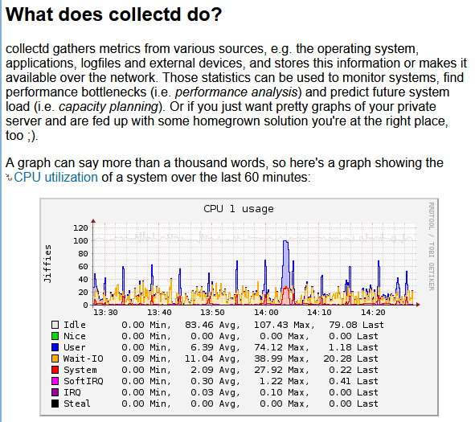
Hardware Data
The Hardware side
Nagios
collectd
Windows: PerfMon
MetricBeat
Caveat: You have to start some kind of monitoring daemon on each physical machine ☹. Fiddling.

Slide 28
Architecture + Domain Data
Require logging in applications + Log aggregation
Syslog (from the 1980’ies!)
ELK
And a zillion more, lots of vendors in this space…

Slide 29
Logging Versus Metrics
Back to Adrian Cole
Logs: events emitted
Log.info(“method=foo(), param=7”);
Metrics: periodic aggregations
meter = new Meter(“getQuote-requests”)
meter.mark()
Counts all ‘mark()’ calls associated with that meter
Emits log message every 5 minutes with aggregated statistics
Return to that later ☺…

Slide 30
Our Choice in MSDO
Humio

Slide 31

Why Humio?
Humio because
Community SaaS offering for free
Built-in tutorial ☺
Lower the learning curve
I made it run in one hour
Compared to the tears I shed doing ELK
It was a Danish (start-up) company
Now sold for an astronomical amount
And, I know the founder personally ☺

Slide 32
Metrics Libraries
Example: Dropwizard Metrics
Just a simple Coding Kata

Slide 33
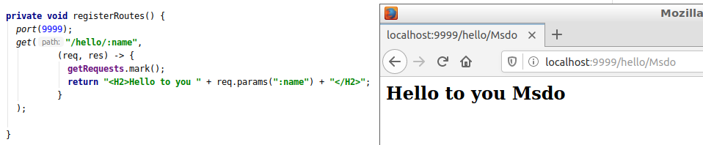
Hello World Web App
The simplest ‘Hello World’ Spark-Java server:
Notes:
Meta: Code in /programmingkata/learn-metrics

Slide 34
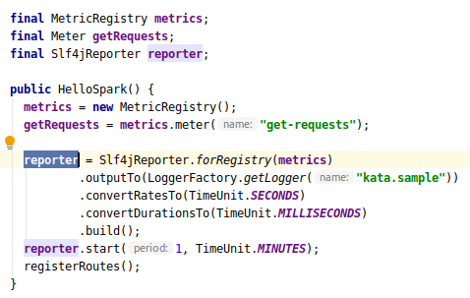
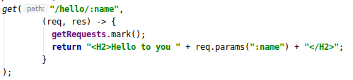
Monitoring it
The Registry; the Meter; and the Slf4J Reporter
Meter = ‘rate’, events pr second

Slide 35
Output to Log4J
Total counts, 1 minute mean, 5 minute mean, etc.

Slide 36
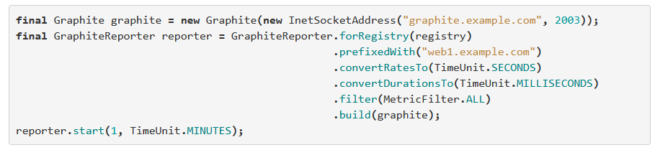
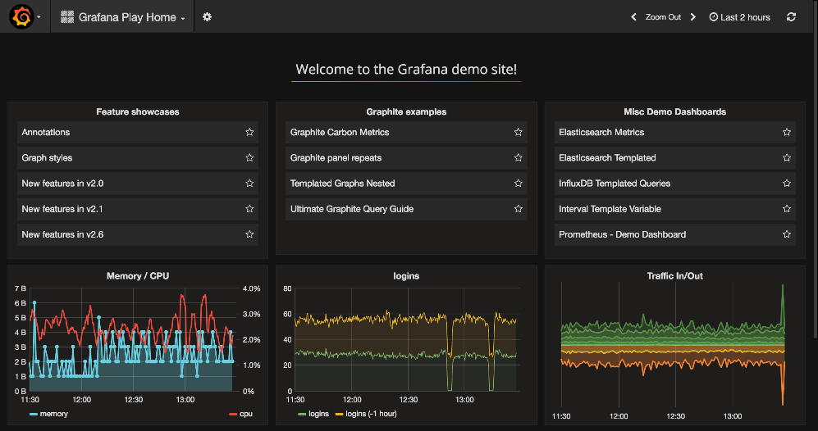
Alternative: Graphite
Alternatively, output is sent to Graphite

Slide 37
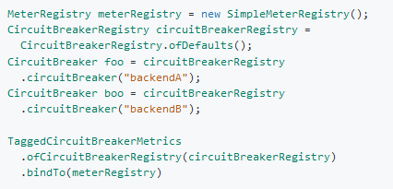
Other Metrics Library
Micrometer
Integration with Resilience4J!
So now your CB data is aggregated and logged periodically…
And Micrometer can send data to Humio…

Slide 38
Non-invasive Logging

Slide 39
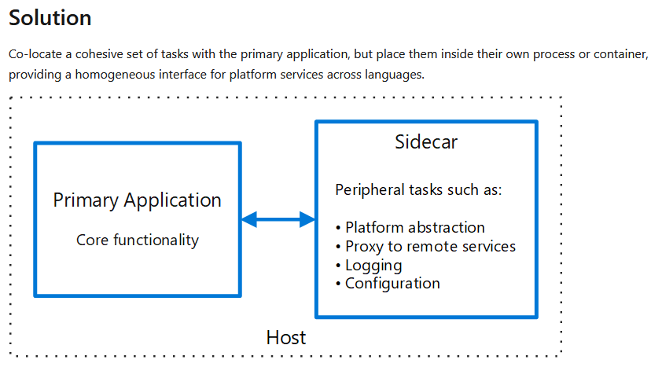
Sidecars
‘Decorator pattern’ on services
https://docs.microsoft.com/en-us/azure/architecture/patterns/sidecar

Slide 40
Summary
Phew…
Vast and important topic
I looked real hard to find a terminology strong classification of the topic…
I am still searching
But – the key concepts are…

Slide 41
Key Concepts
Monitorability: Ability to monitor system while executing, to take corrective action in case of potential problems
Classes of data
Hardware data, architectural data, domain data
Classes of ‘events’
Logging (event), Metrics (aggregates), Traces (correlated events)

